Slide 1
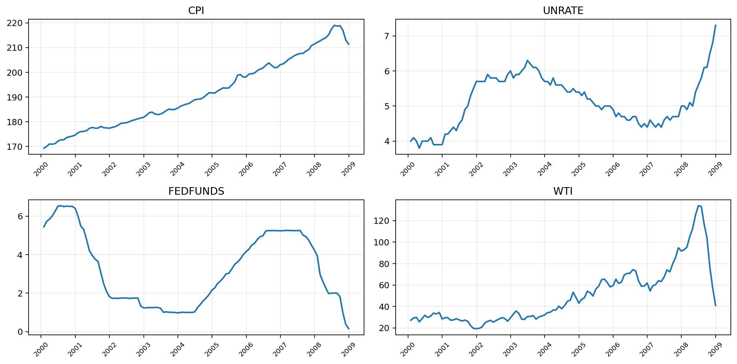
Finance & Economics
Time-Series Analysis
Data Science Bootcamp Project
Objective
Analyze historical financial and economic indicators (2000–2008) to identify trends, relationships, and predictive patterns using time-series analysis.
6
108
0
Economic indicators
Market behavior
Future trends
monthly series
monthly rows
raw missing
Notes:
[Sources] - User-uploaded notebook: /mnt/data/bootcamp_project.ipynb - User-uploaded FRED CSV files in /mnt/data

Slide 2
Project Objectives
1
Background and dataset information
2
Use SQL to import data
3
Implement AR, MA, ARMA, and ARIMA models
4
Analyze results by MAE, RMSE, MAPE
5
Future improvements

Slide 3
Problem Statement
Financial markets and the global economy are deeply interconnected.
Who benefits?
Key indicators such as GDP growth, inflation rates, interest rates, and stock market performance influence one another in complex ways.
Policymakers
Monitor inflation, growth, and rate conditions.
Challenge
Investors
Track cycles, volatility, and market timing signals.
Understanding these relationships is difficult, but essential for policy, investing, and business decisions.
Goal
Businesses
Plan pricing, production, and financing decisions.
Use data analysis and modeling to uncover patterns and support better decision-making.

Slide 4
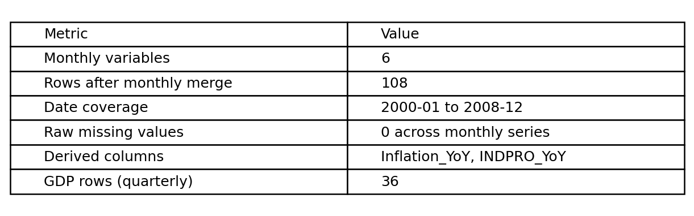
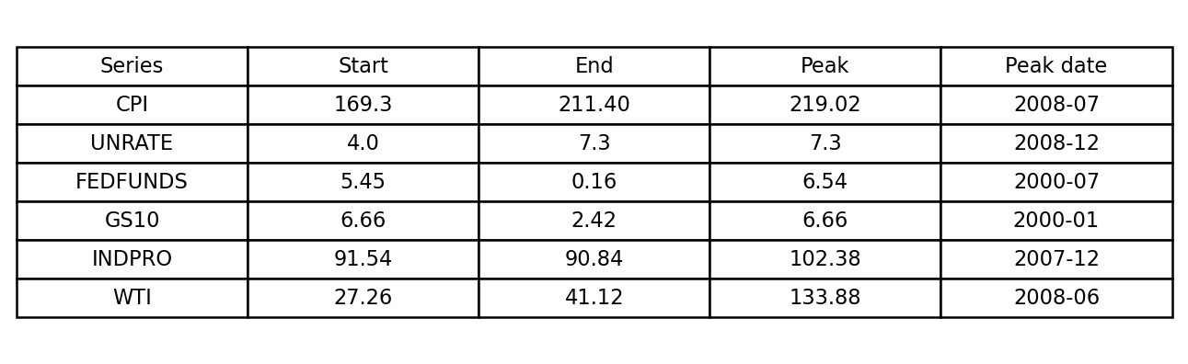
Dataset Overview
Dataset
Finance & Economics Time-Series Dataset
Time Period
2000 – 2008
GDP (kept separately as quarterly)
Inflation proxy: CPI and Inflation_YoY
Interest rates: FEDFUNDS and GS10
Economic indicators: UNRATE, INDPRO, WTI
Stock market index can be added later as an extension
Data Type
Time-series data collected at regular intervals.
Notes:
[Sources] - User-uploaded notebook and CSV files in /mnt/data

Slide 5
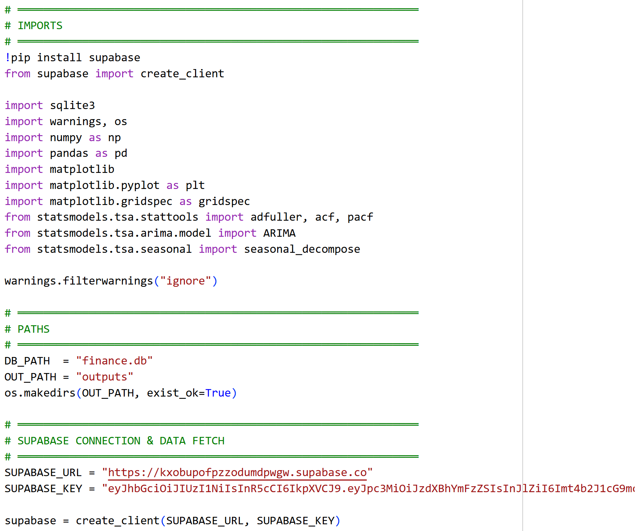
SQL database
Created account in Supabase
Uploaded datasheet manually to Supabase
Fetch data and convert it to DataFrame in Python.
Notes:
[Sources] - Plot recreated from user-uploaded CSV files in /mnt/data

Slide 6
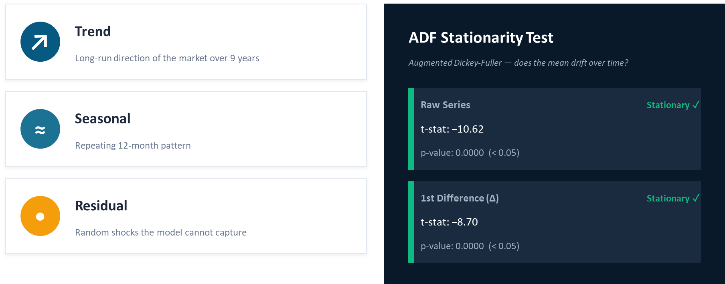
Decomposition & Stationarity

Slide 7
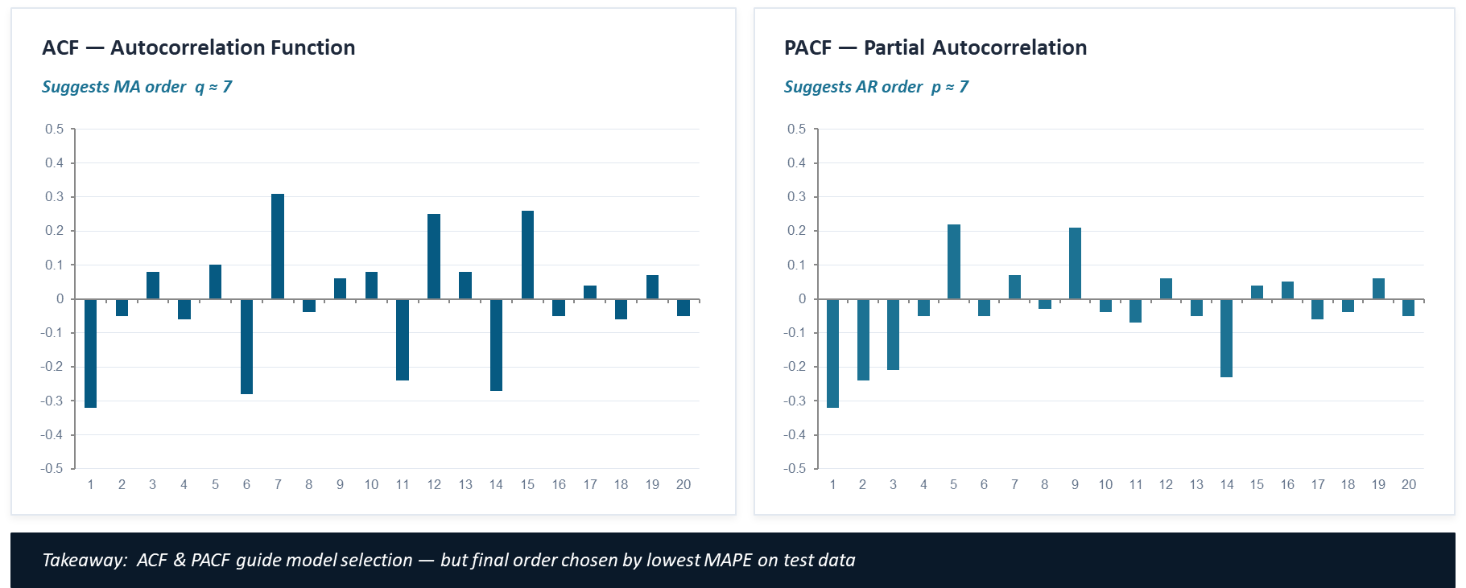
AR, MA, ARMA, and ARIMA models
Notes:
[Sources] - Missing-value results from user-uploaded notebook and CSV files

Slide 8
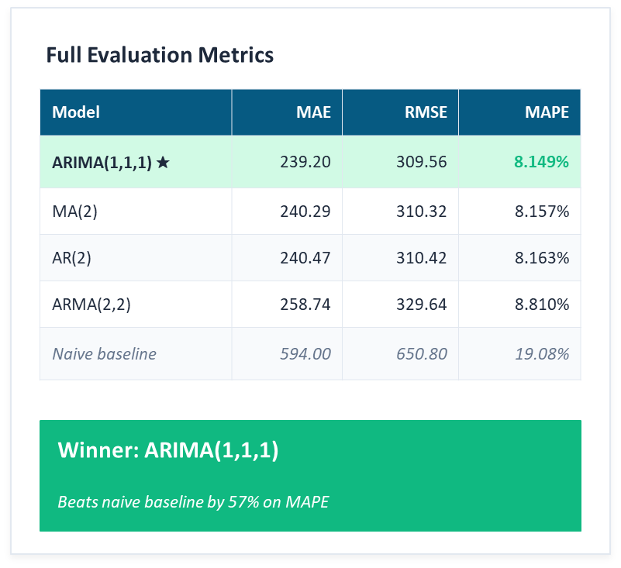
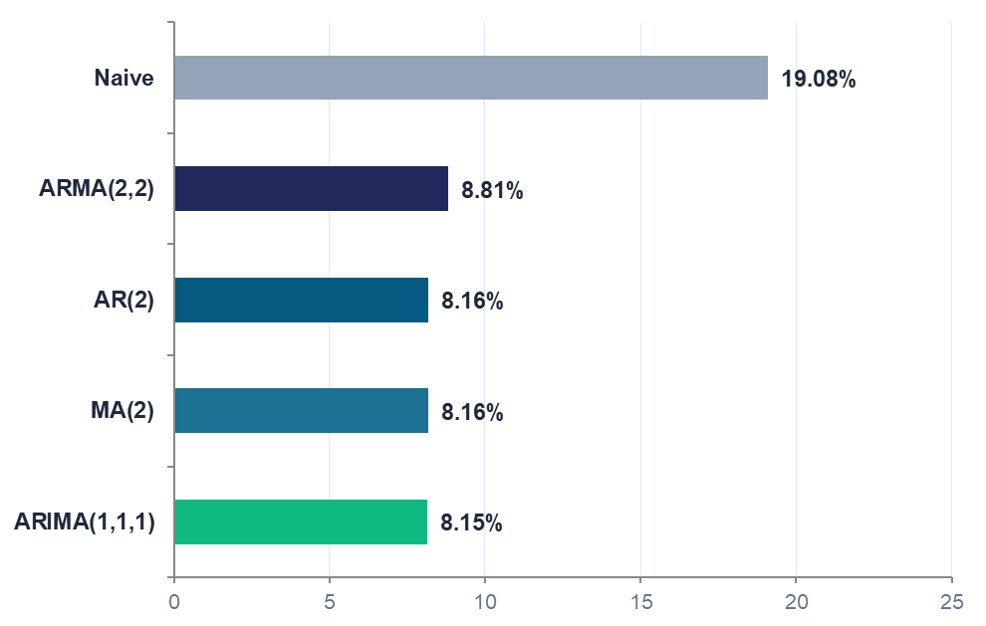
Model Comparison
MAPE — Lower is Better

Slide 9
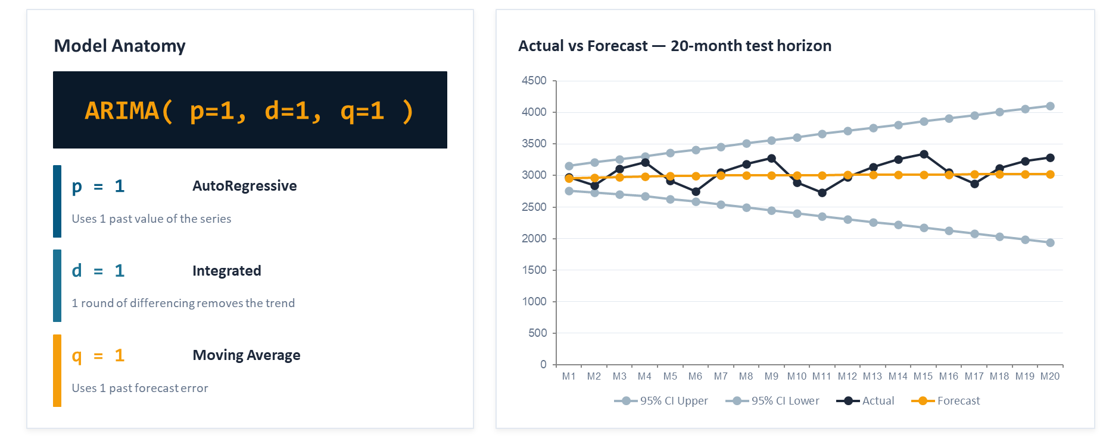
Best Model: ARIMA(1,1,1)

Slide 10
Key Takeaways
RESULTS
3,000-row dataset cleaned, feature-engineered, and loaded into SQLite
4 SQL queries extracted cross-sectional and temporal economic insights
S&P 500 monthly series is non-stationary; 1st differencing resolves this
ARIMA(1,1,1) achieves best MAPE — d=1 differencing properly removes the non-stationary trend in S&P 500 close prices
All 4 models (AR, MA, ARMA, ARIMA) outperform the Naive baseline

Slide 11
Future Improvements
VAR Model
Model all 6 indicators simultaneously to capture cross-series dependencies.
LSTM/GRU
Deep learning for non-linear, long-range sequential patterns
SARIMA
Extend ARIMA to explicitly model seasonality (seasonal d, P, D, Q)
Interactive Dashboard
Streamlit or Plotly Dash - filter by index, indicator, and forecast horizon.

Slide 12
Thank You!
GitHub Link: k4ju1/DS-Bootcamp-Final: DS Bootcamp Final

